Slide 1
Software Analysis and Design (CS:324)
Entity Control and Boundary Classes

Slide 2
ECB(Robustness Analysis):
The Robustness Analysis is a practice that originated with Ivar Jacobson’s Objectory Method. (also called Jacobson’s diagram)
This involves analyzing the narrative text of use cases, identifying the first-guess set of objects that will participate in those use cases, and classifying these objects based on the roles they play.
Robustness analysis helps you to bridge the gap from Use Cases and Domain Classes.

Slide 3
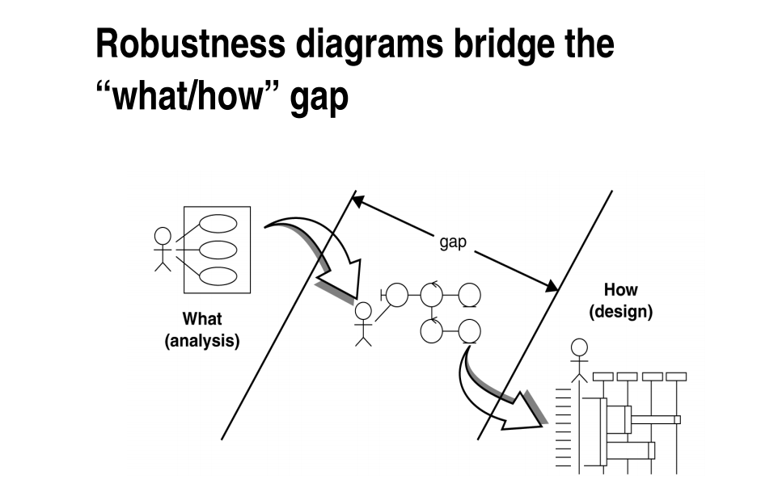

Slide 4
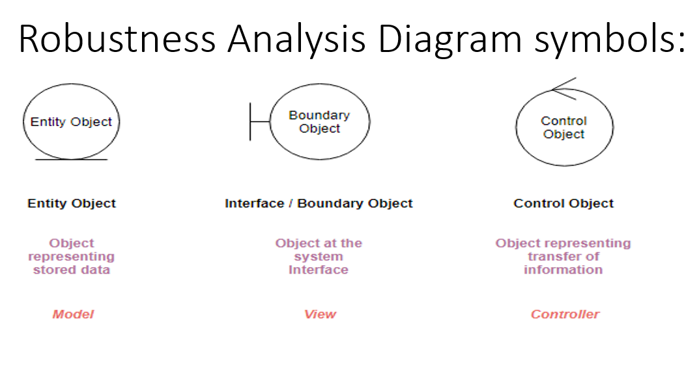
ECB partitions the system into three types of classes: entities, controls, and boundaries.
entity, control, and boundary are official UML class stereotypes. UML has some special icons to represent them.

Slide 5
Boundary object (or interface object) is what actors use in communicating with the system.
Entity object Entities are objects representing system data: Customer, Product, Transaction, Cart, etc.
Control objects (also known as controllers in MVC), which serve as the “glue” between boundary objects and entity objects.

Slide 6
Several Types of Boundary Classes
User interface classes –
Classes that facilitate communication with human users of the system Menus, forms, etc. User interface classes.
System interface classes :
Classes which facilitate communications with other systems.
These boundary classes are responsible for managing the dialogue with the external system, like getting data from an existing database system or flat file.
Provides an interface to that system for this system
Device Interface Classes
Provide an interface to devices which detect external events – like a sensor or …
One boundary class per use case/actor pair

Slide 7
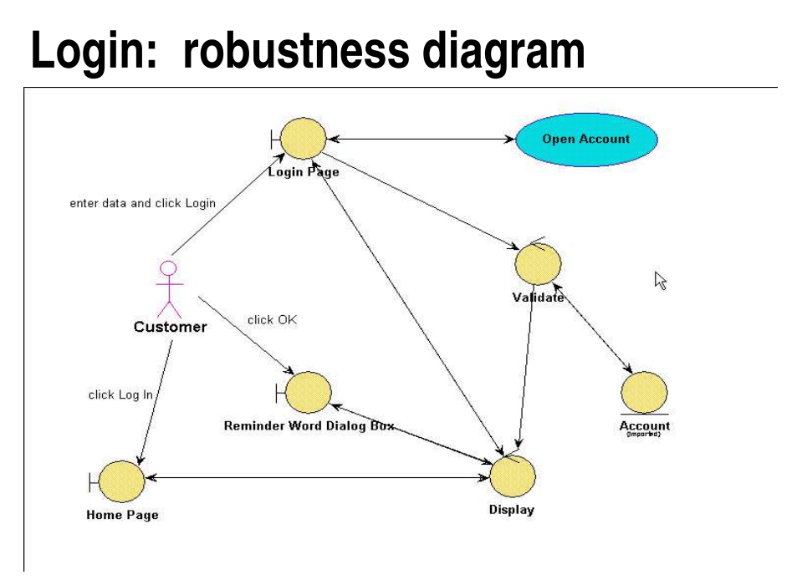
Robustness Analysis Diagram at a Glance:
Suppose we have the following simple use case description in textual format:
Login: use case text
Basic Course: The Customer enters his or her user ID and password, and then clicks the Log In button. The system validates the login information against the persistent Account data, and then returns the Customer to the Home Page.

Slide 8
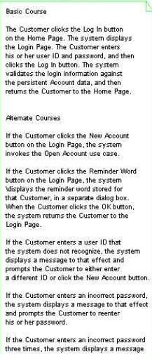
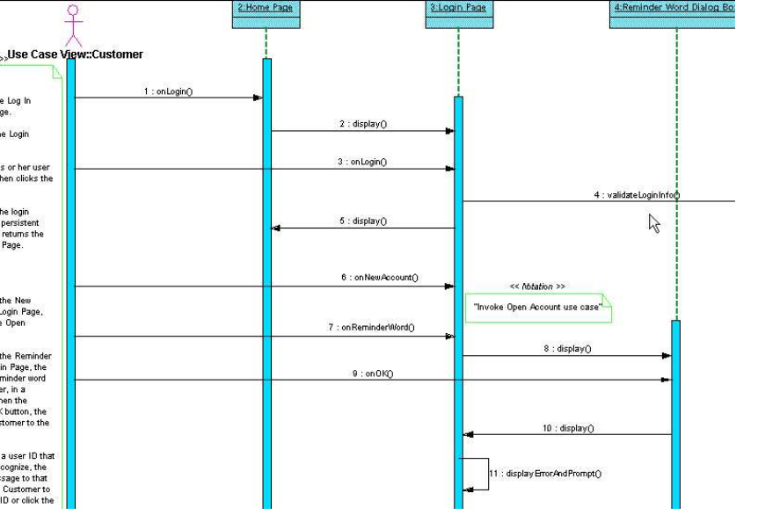
Login Sequence diagram:

Slide 9
Edit Shopping Cart use case text:
Basic Course:
On the Shopping Cart Page, the Customer modifies
the quantity of an Item in the Shopping Cart, and then presses the
Update button. The system stores the new quantity, and then
computes and displays the new cost for that Item.
Alternate Course:
If the Customer changes the quantity of the Item
to 0, the system deletes that Item from the Shopping Cart.

Slide 10
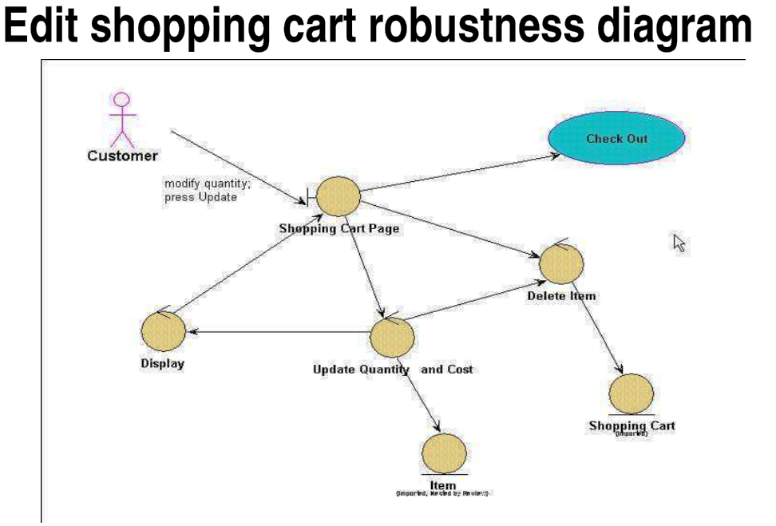

Slide 11
Robustness Diagram – 4 Connection Rules
Keep in mind that both boundary objects and entity objects are nouns and that controllers are verbs. Nouns can’t talk to other nouns, but verbs can talk to either nouns or verbs.
Here I listed the four basic connection rules which should always be mind:
Actors can only talk to boundary objects.
Boundary objects can only talk to controllers and actors.
Entity objects can only talk to controllers.
Controllers can talk to boundary objects and entity objects, and to other controllers, but not to actors.

Slide 12
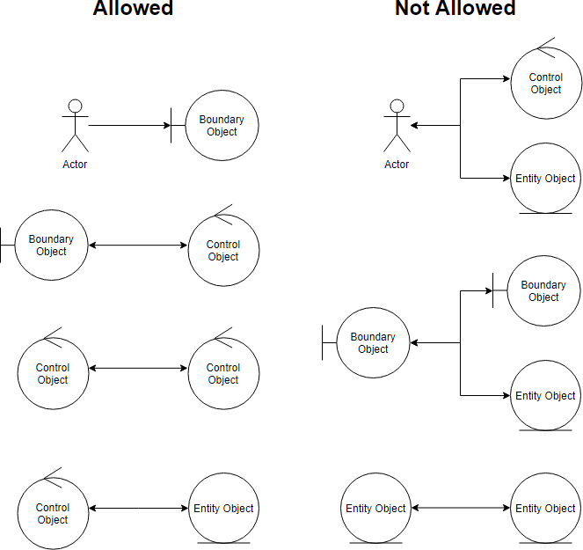
Robustness Analysis Diagram connection rules:

Slide 13
Five Steps for Creating Robustness Analysis:
You perform robustness analysis for a use case by walking through the use case text.
One sentence at a time, and drawing the actors, the appropriate boundary, entity objects and controllers, and the connections among the various elements of the diagram.
You should be able to fit the basic course and all of the alternate courses on one diagram.
Anyone who reviews a robustness diagram should be able to read a course of action in the use case text, trace his finger along with the associations on the diagram, and see a clear match between text and picture.

Slide 14
